Slide 1
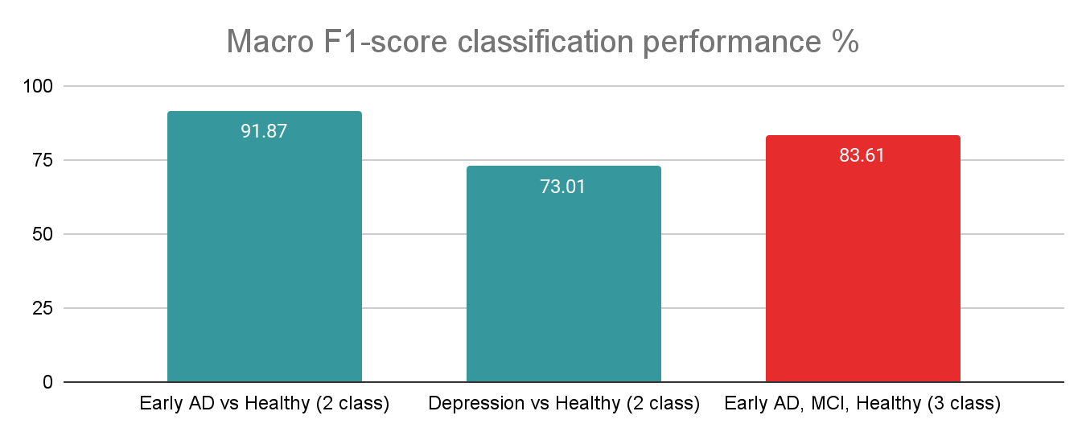
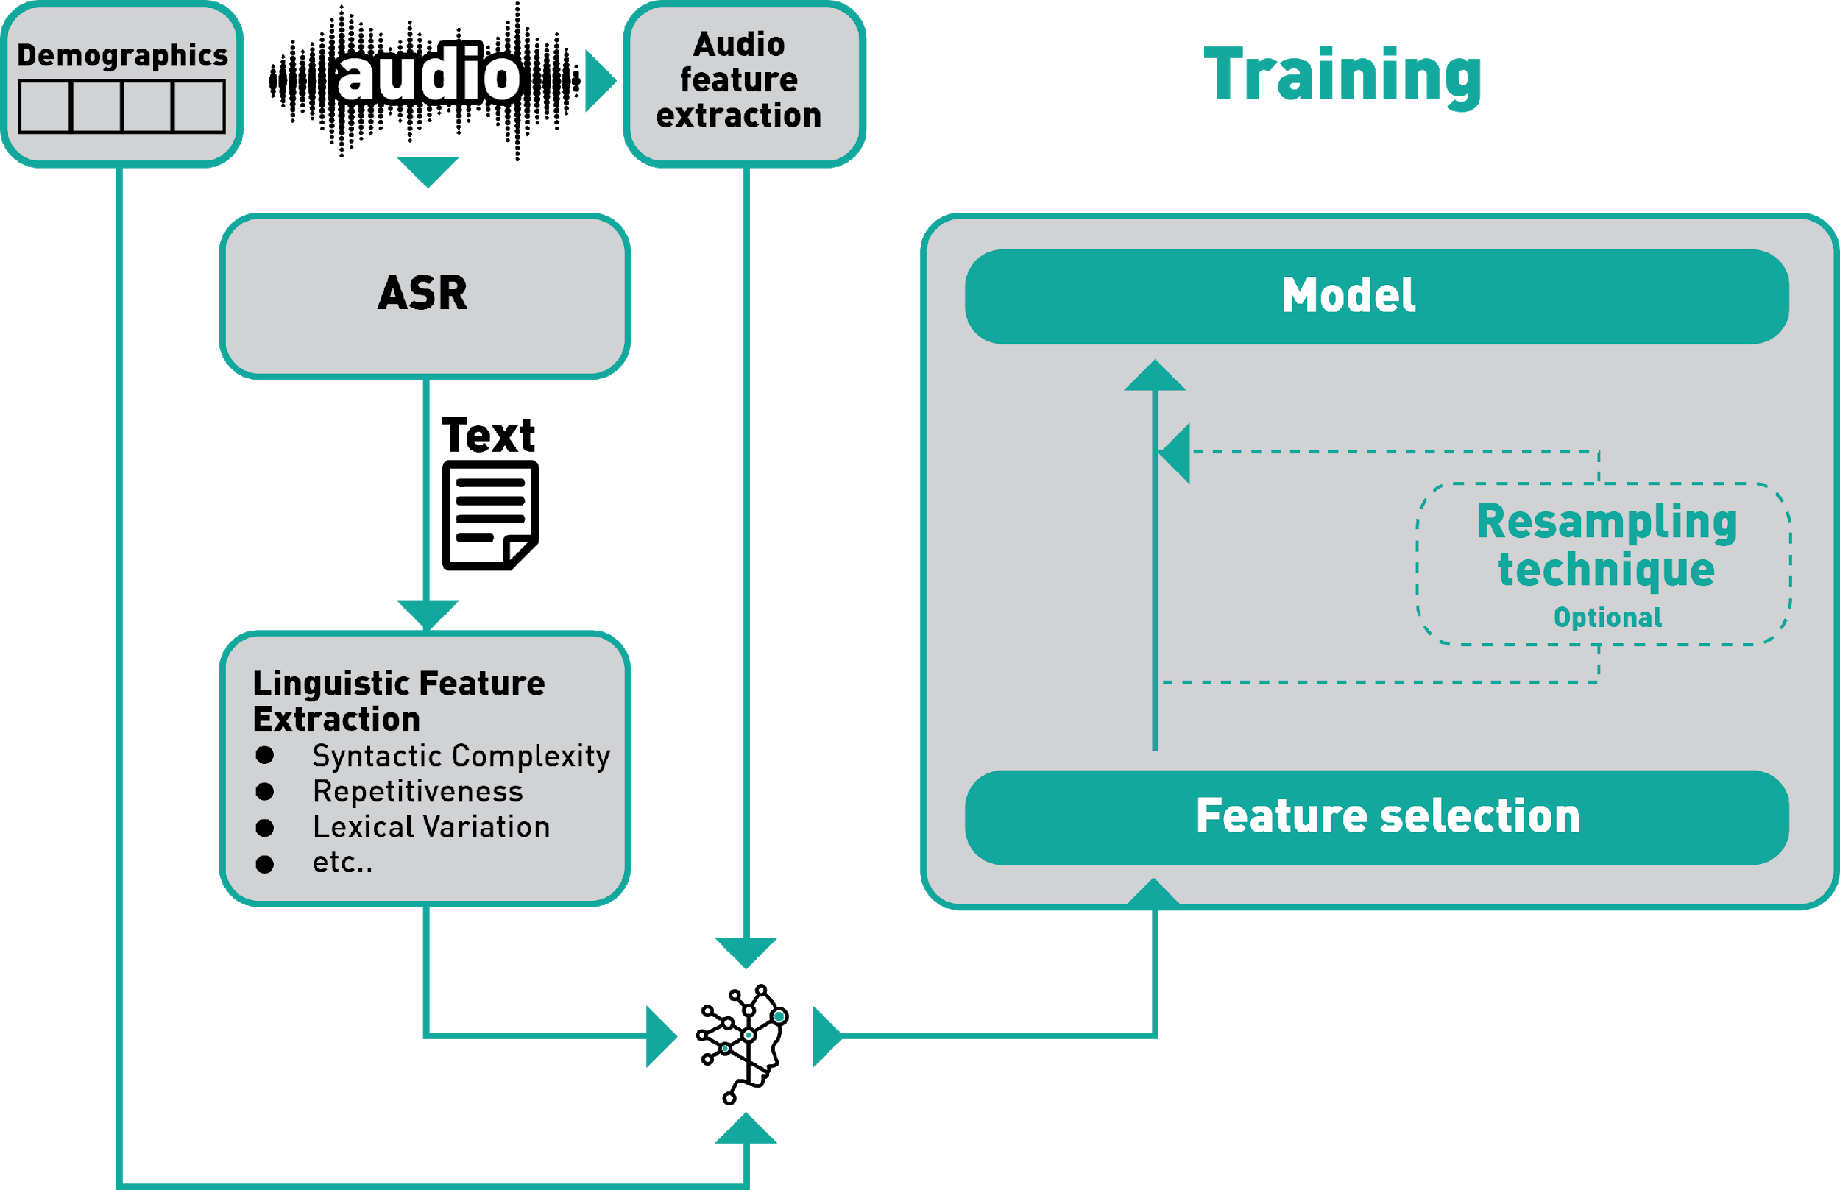
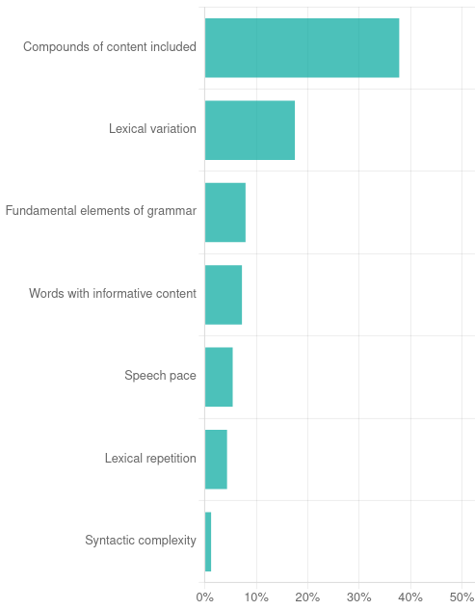
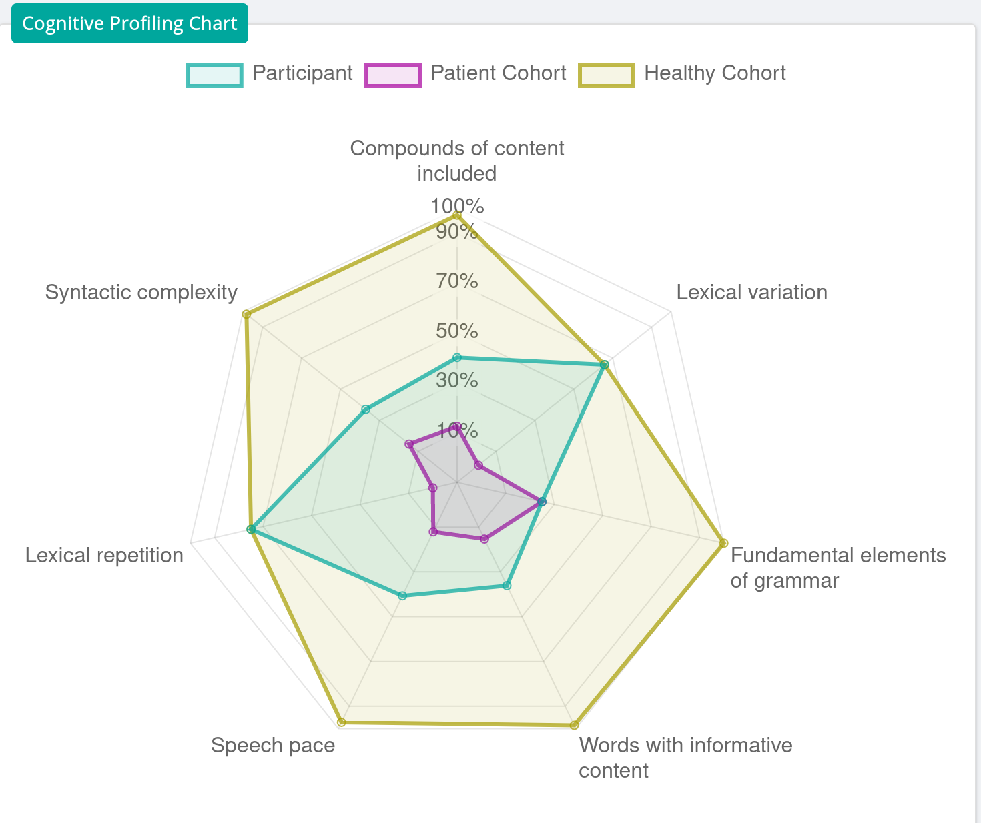
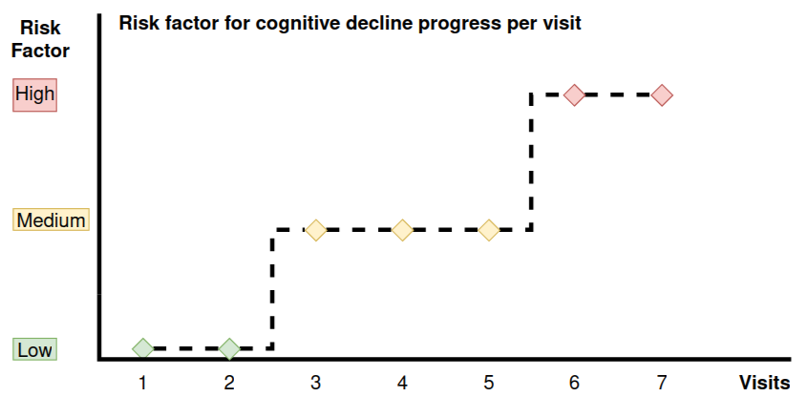
Towards Automatic Early Detection: Assessing LANGaware's Language and Speech Biomarkers in Neurocognitive and Affective Disorders
Vassiliki Rentoumi, PhD¹, Evangelos Vassiliou, PhD², Nikiforos Pittaras, PhD³, Admir Demiraj, MSc¹, George Paliouras, PhD³ and Dimitra Sali, MD, PhD⁴
(1) LANGaware Inc, Menlo Park, CA, USA, (2) Department of Financial and Management Engineering, School of Engineering, University of the Aegean, Chios, Greece, (3) NCSR Demokritos, Athens, Greece, (4) Aiginiteio University Hospital, Athens, Greece
Background
Approach
Experimental Results
Cognitive decline (CD) is linked to diseases / disorders of varying severity levels (e.g. in Alzheimer’s and Depression) and is often associated with changes in spoken language
We develop a Machine Learning (ML) workflow based on multimodal biomarkers to automatically facilitate the early detection of such diseases, across different languages
We showcase the efficacy of our approach over speech recordings from pathological and age-matched healthy cohorts, covering multiple languages, diseases and disorders, using diverse cohort and data collection protocols
Database: over 21,500 audio recordings from people in the Greek & English language
People with early Alzheimer’s Disease (AD), MCI, Depression, as well as Normal Controls (NC), labeled by medical experts
Tasks: free-speech / everyday task description / over-learned narrative and others
Experimental setup using data from different domains (clinics, hospitals, elderly care facilities), cognitive assessment tasks and demographics (background, gender and age group)
Evaluation across languages and radically different diagnoses:
Early AD vs Healthy: train: 1414 / test: 111
Depression vs Healthy: train: 725 / test: 73
3 way Classification across languages and radically different diagnoses:
Early AD, MCI, Healthy: train: 869 / test: 254
Motivation
Early diagnosis
Early intervention
& therapeutics
Progression delay
Symptoms alleviation
Symptoms of CD: anxiety, mood changes, memory loss, difficulty in everyday tasks
Changes in acoustic / linguistic attributes and patterns of spoken language
Subtle but detectable by advanced Feature Extraction, AI & ML methods
Lack of methods robust in detecting cognitive decline of different severity levels
Decision support for efficient diagnosis of neurodegenerative diseases and disorders
Performance over 90% for the Healthy vs early AD differentiation task and 73% for Depression vs Healthy differentiation task across languages, using the same methodology
Models generalize and showcase robustness across disease / disorder, language setting and patient characteristics
Developed biomarkers useful for speech / language analysis in diseases / disorders of different severity
Where we fit in Healthcare
Where we fit in the Pharmaceutical Industry
LANGaware Analytics Platform
Post-Diagnostic
Services
Post-diagnosis support
Increases accuracy & shortens time of population recruitment in clinical trials
Detects the disease at an earlier stage
Remotely monitors cognitive changes over time
Cohort Comparison: Analytics of patient performance against patient / control cohorts
Model Interpretation: How specific language attributes contribute to predictions
Customizable visualizations offer aggregated or detailed patient views
Language features are extracted from text generated by state of the art ASR
Audio features and demographics are combined to form the final feature vector
Extensive feature selection selects the most salient cognitive digital biomarkers differentiating the patient cohort from the control cohort, across languages
An artificial neural network architecture is utilized to train a classification model, using cross-validation and a separate test set
Neurology
Clinics
Informed decisions
Verify cognitive decline
Differential diagnosis
LANGaware Analyics Platform
Memory
Services/Clinics
Primary Care
Physicians
Early diagnosis
Population screening
Reduce unnecessary referrals
Maximizes success of trials
Reduces the cost of trials
Provides the therapeutic to a wider audience
Monitors the effectiveness of the provided treatment
Longitudinal Monitoring
Remote monitoring
for people at high risk & post-diagnosis monitoring
Longitudinal monitoring with respect to elapsed time or patient visits
Enables remote patient cognitive status tracking
Facilitates close monitoring of disease progression and symptom evolution across time
Conclusions
Evaluation shows that the developed biomarkers are capable for efficient disease / disorder classification
Proposed workflows are robust to different languages, diseases / disorders of different severity levels, as well as resilient to dataset profile variations in dataset size, domain and cohort demographic details
Langaware’s biomarker suite provides a solution able to generalize in diverse settings, use cases and target diseases, offering dependable early diagnosis functionality for efficient decision support
LANGaware: introducing the right solution for the early detection of neurodegenerative and psychiatric diseases
Notes:
‹#›
‹#›
‹#›
‹#›

